Slide 1
Exploratory Data Analysis and Data Visualization
Deepak Kumar (Data Scientist, BT&E)
Anusha Pai (Data Scientist, Boeing AI)

Slide 2
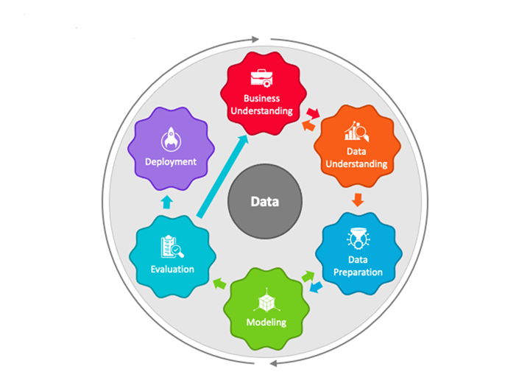
ML Use case Lifecycle
Image source: https://www.sketchbubble.com/en/presentation-crisp-dm.html

Slide 3
Outline
EDA Visualization
Univariate Analysis (One variable)
Bivariate Analysis (Two variables)
Multivariate Analysis (More than two variables)
Dimensionality Reduction
Clustering Analysis

Slide 4
EDA and Visualization
Exploratory Data Analysis (EDA) and Visualization are very important steps in any analysis task.
get to know your data!
distributions (symmetric, normal, skewed)
data quality problems
outliers
correlations and inter-relationships
subsets of interest
suggest functional relationships
Sometimes EDA might be the goal!

Slide 5
Exploratory Data Analysis (EDA)
Goal: get a general sense of the data
means, medians, quantiles, histograms, boxplots
You should always look at every variable - you will learn something!
data-driven (model-free)
Think interactive and visual
Humans are the best pattern recognizers
You can use more than 2 dimensions!
x,y,z, space, color, time….
Especially useful in early stages of data mining
detect outliers (e.g. assess data quality)
test assumptions (e.g. normal distributions or skewed?)
identify useful raw data & transforms (e.g. log(x))
Bottom line: it is always well worth looking at your data!

Slide 6
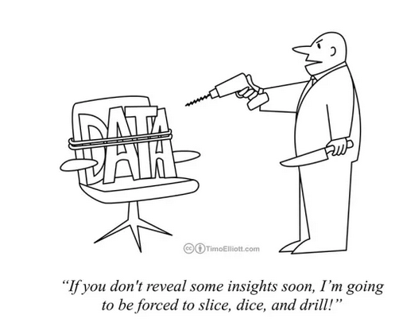

Slide 7
Univariate Analysis
Focuses on analyzing a single variable at a time
Helps understanding the variable's distribution, central tendency, and spread.
Techniques:
Descriptive statistics (mean, median, mode, variance, standard deviation, skewness).
Visualizations (histograms, box plots, frequency table, bar charts, pie charts).

Slide 8
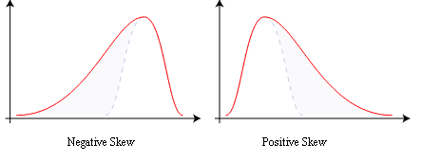
Central tendency measures (mean, median, mode)
mean: μ = ∑_{i} X_{i} / n
mode: most common value in X
median: X=sort(X), median = X_{n/2} (half below, half above)
Dispersion measures (range, variance, standard deviation)
variance: σ² = ∑_{i} (X_{i} - μ)² / n
skewness: ∑_{i} (X_{i} - μ)³ / [ (∑_{i} (X_{i} - μ)²)^{3/2} ]
zero if symmetric; right-skewed more common (what kind of data is right skewed?)

Slide 9
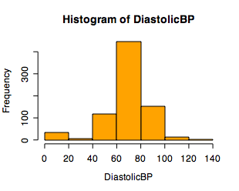
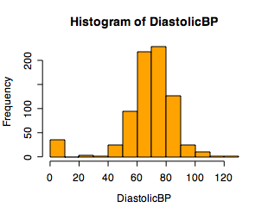
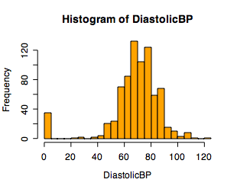
Single Variable Visualization
Histogram:
Shows center, variability, skewness, modality,
outliers, or strange patterns.
Bin width and position matter
Beware of real zeros

Slide 10
Limitation with Histograms
For small data sets, histograms can be misleading.
Small changes in the data, bins, or anchor can deceive
Histograms do not directly show mean, median, quartiles, or outliers.
Histograms effectively only work with 1 variable at a time

Slide 11
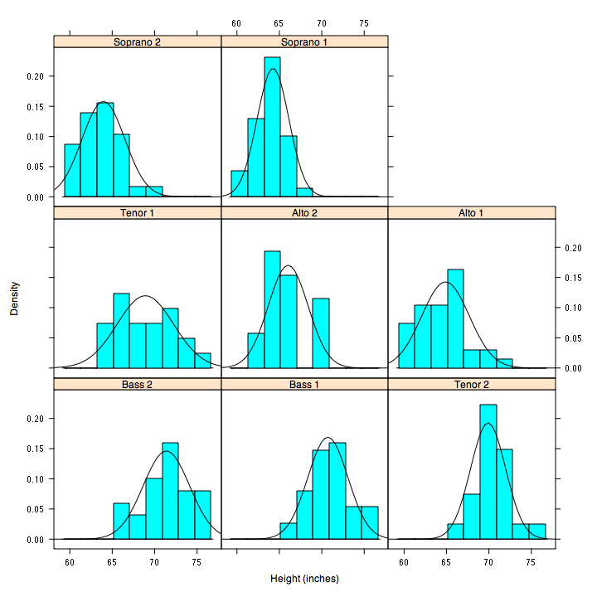
Smoothed Histograms - Density Estimates
Showcases underlying probability density function rather than simply counting data points in bins.

Slide 12
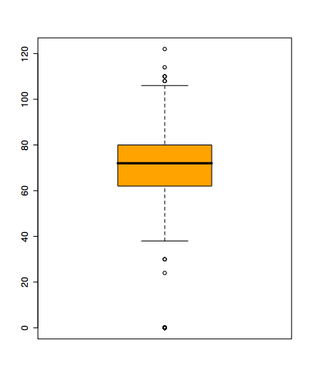
Boxplots
Shows a lot of information about a variable in one plot
Median
IQR
Outliers
Range
Skewness
Negatives
Loss of distribution detail
May be misleading with few data points
Notes:
Horizontal line in box is median (Q2)
Top and bottom of plot are always Q1 and Q3
Whiskers can mean several things: usually these are the minimum and maximum of all of the data
Values outside this range are pkptted as outliers (circles)

Slide 13
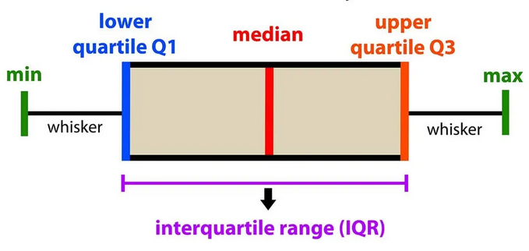
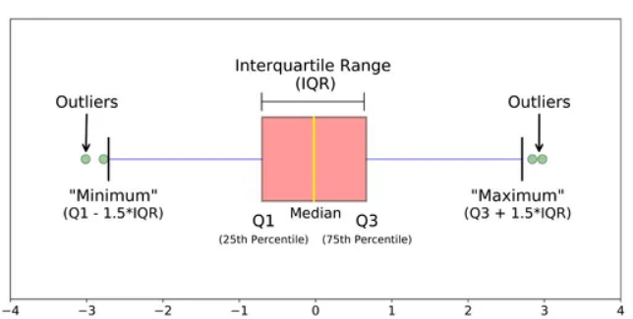
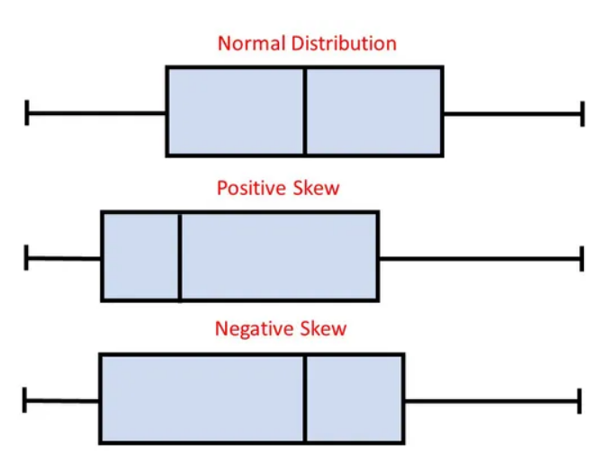
Source: https://towardsdatascience.com/

Slide 14
What If variable is categorical ??
Examples of categorical variables
Nationality
customer's satisfaction
Organization name
job titles
Blood type

Slide 15
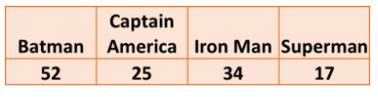
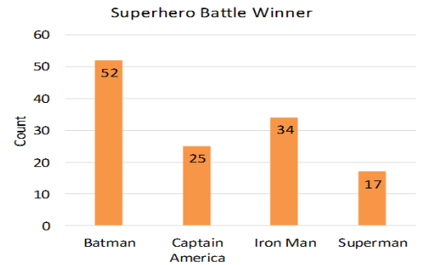
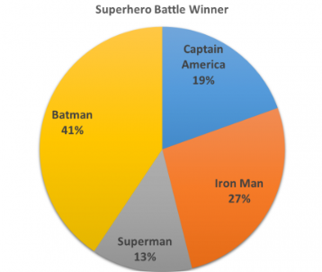
Frequency Table
Bar charts
Pie charts

Slide 16
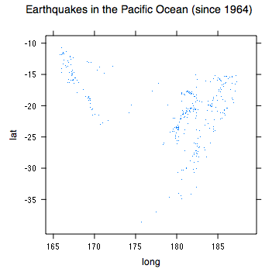
Spatial Data
If your data has a geographic component, be sure to exploit it
Data from cities/states/zip codes – easy to get lat/long
Can plot as scatterplot

Slide 17
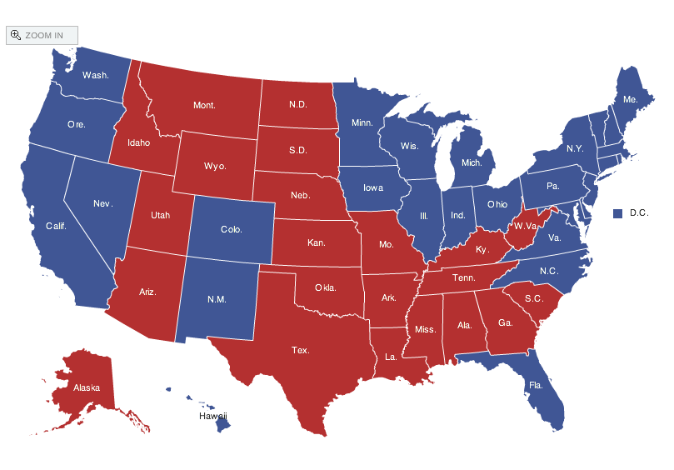
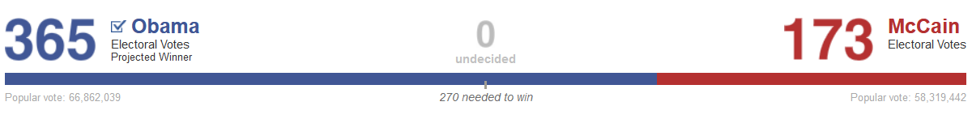
Spatial data: choropleth Maps
Maps using color shadings to represent numerical values are called chloropleth maps
http://elections.nytimes.com/2008/results/president/map.html

Slide 18
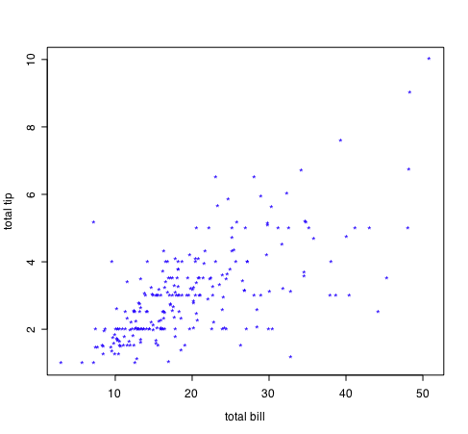
Two Continuous Variables
For two numeric variables, the scatterplot is the obvious choice
interesting?
interesting?

Slide 19
2D Scatterplots
standard tool to display relation between 2 variables
useful to answer:
x,y related?
linear
quadratic
other
variance(y) depend on x?
outliers present?
interesting?
interesting?

Slide 20
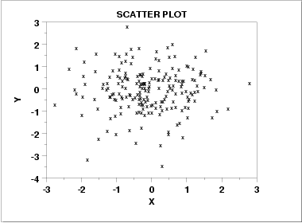
Scatter Plot: No apparent relationship

Slide 21
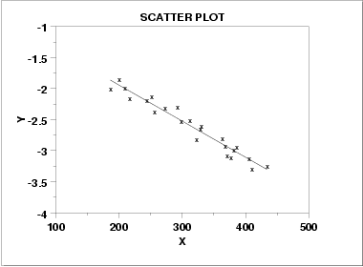
Scatter Plot: Linear relationship

Slide 22
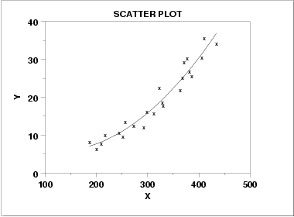
Scatter Plot: Quadratic relationship

Slide 23
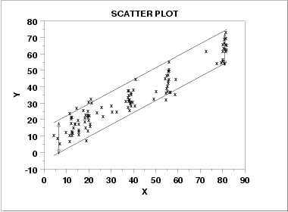
Scatter plot: Homoscedastic
variation in Y is constant with varying value of X

Slide 24
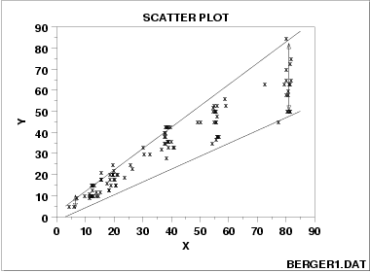
Scatter plot: Heteroscedastic
variation in Y differs depending on the value of X

Slide 25
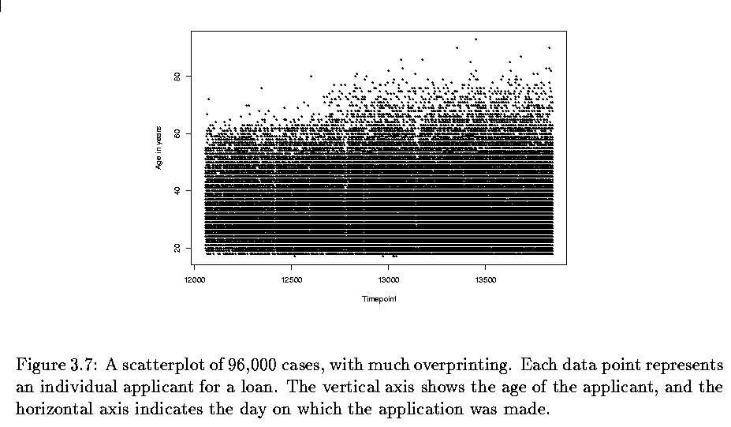
Two variables - continuous
Scatterplots can be bad with lots of data

Slide 26
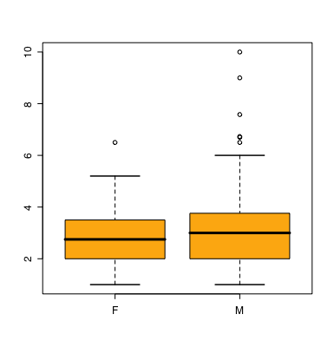
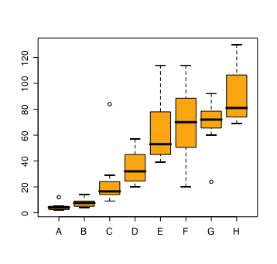
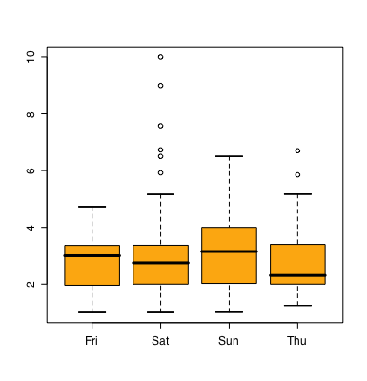
Two Variables - one categorical
Side by side boxplots are very effective in showing differences in a quantitative variable across factor levels
tips data
do men or women tip better
orchard sprays
measuring potency of various orchard sprays in repelling honeybees

Slide 27
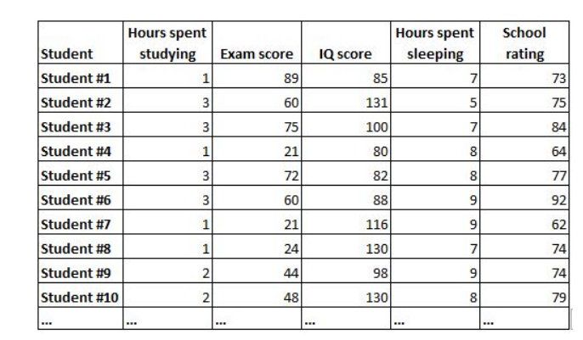
Correlation Matrix

Slide 28
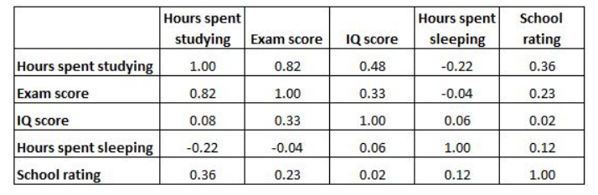
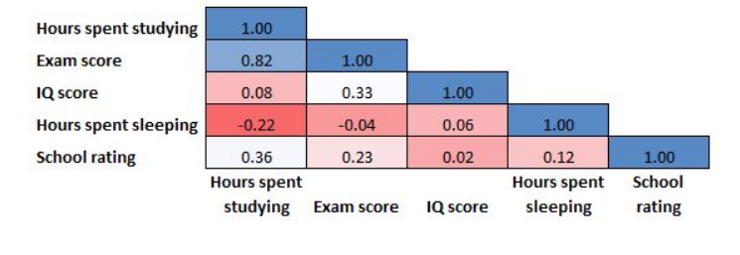

Slide 29
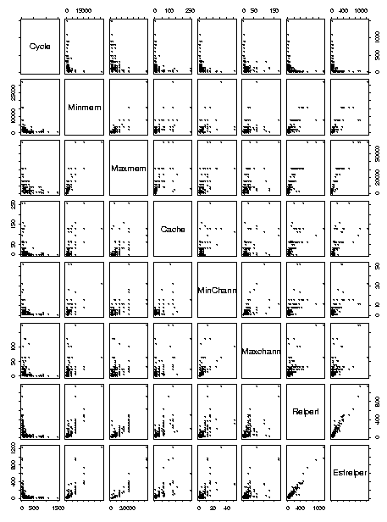
More than two variables
Pairwise scatterplots
Can be ineffective for categorical data

Slide 30
Dimensionality Reduction
Stepwise feature elimination
Principal Component Analysis (PCA)

Slide 31

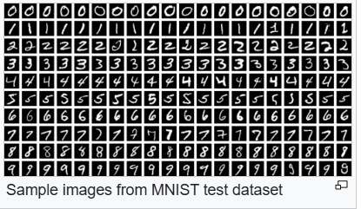
Dimensionality Reduction
T-distributed stochastic neighbor embedding (T-SNE)
The MNIST database contains 60,000 training images and 10,000 testing images ( 28x28 pixel )
T-SNE embeddings of MNIST dataset

Slide 32
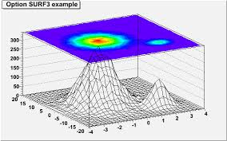
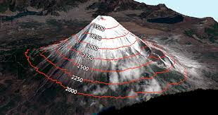
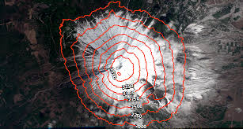
Contour plots
multivariate analysis
visualizing 3-D plots in 2-D space
matplotlib.pyplot.contour() are usually useful when Z = f(X, Y) i.e Z changes as a function of input X and Y
Source: GISGeography

Slide 33
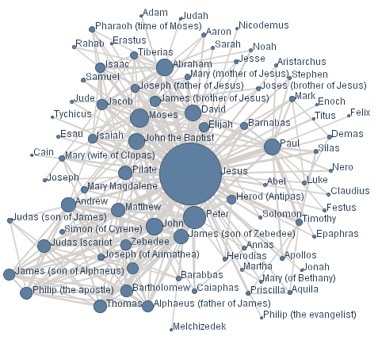
Networks and Graphs
Visualizing networks is helpful, even if is not obvious that a network exists

Slide 34
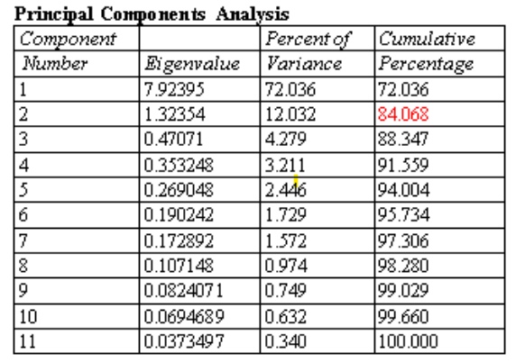
Appendix

Slide 35
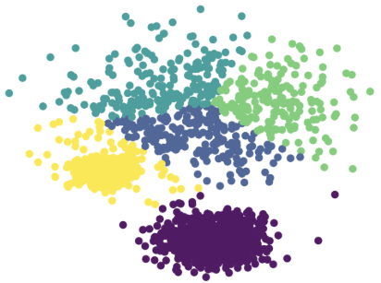
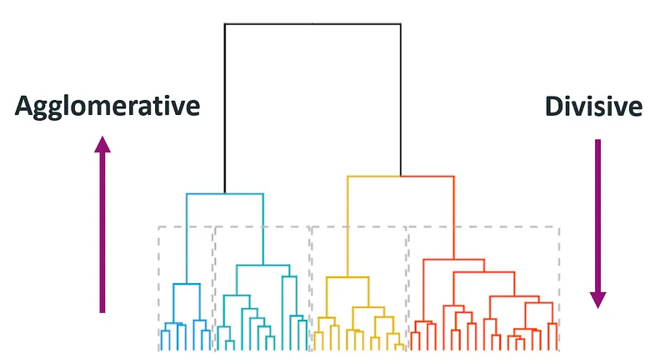
Appendix
Clustering also can be used for Multivariate analysis

Slide 36
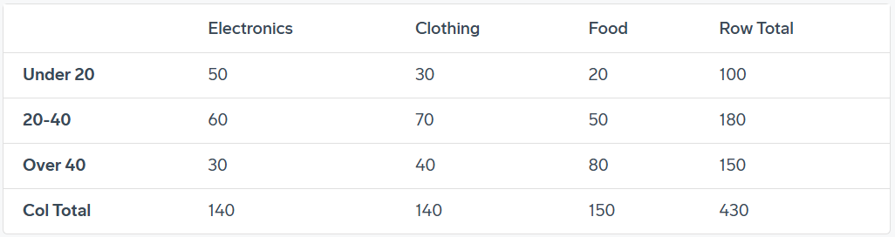
Correlation between two categorical variable
Problem:
A company surveys customers to determine their age group (under 20, 20-40, over 40) and preferred product categories (food, apparel, or electronics).
Investigate the connection between product preference and age group
Solution: Use chi-square test
contingency table (crosstab)

